Slide 1




Fire - climate interactions in a warming world
The extreme 2019 fire year in perspective
The GFED team:
Guido van der Werf (VU), James Randerson (UCI), Louis Giglio (UMD), Dave van Wees (VU), Niels Andela (NASA), Sander Veraverbeke (VU), Douglas Morton (NASA), Joanne Hall (UMD), Yang Chen (UCI)

Slide 2
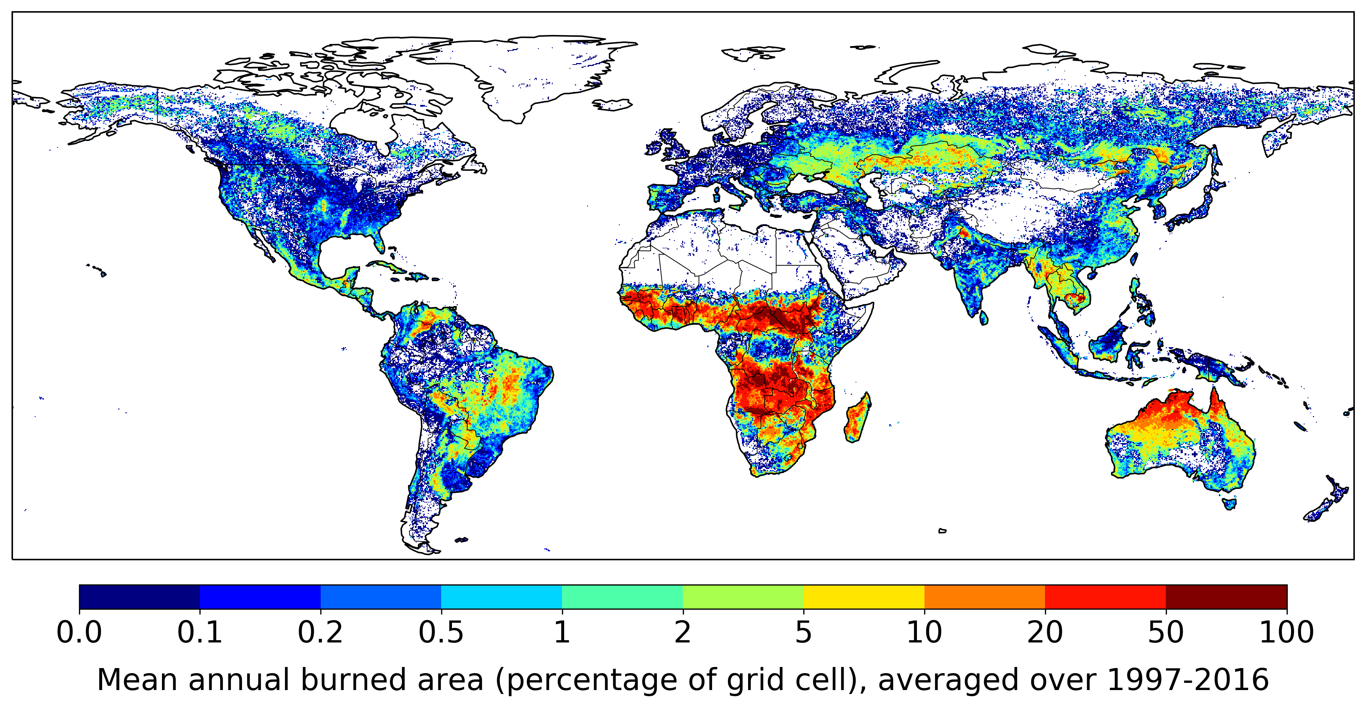
Randerson et al. (2012, JGR-B); Giglio et al. (2013, JGR-B)

Slide 10
Burned area characterization has improved over past decade, wall-to-wall burned area based on moderate resolution satellite data will become available in coming years
Refs: Giglio et al. (2013, JGR-B), Randerson et al. (2012, JGR-B), Giglio et al. (2018, RSE), Roteta et al. (2019, RSE)

Slide 11
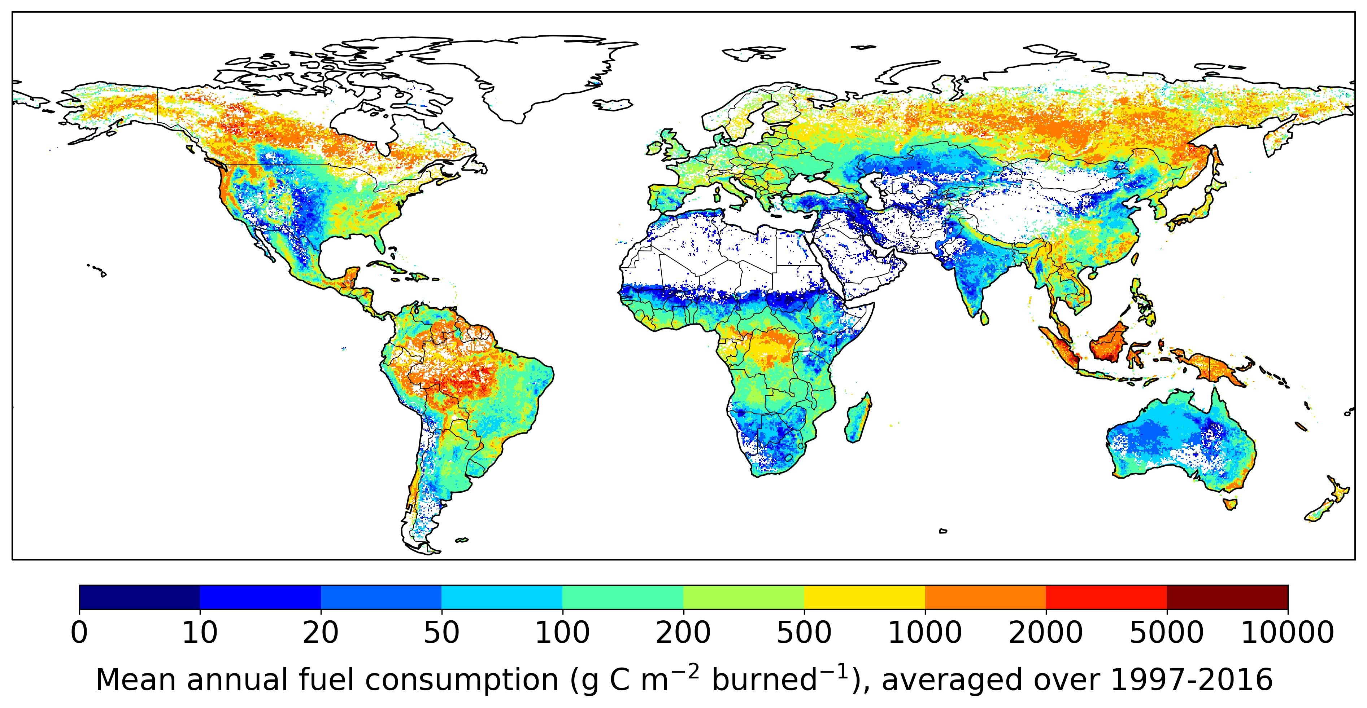
Based on satellite derived vegetation parameters and biogeochemical modeling
Based on GFED data described in Van der Werf et al. (2017, ACPD)
Fuel consumption patterns are the inverse of burned area patterns

Slide 12
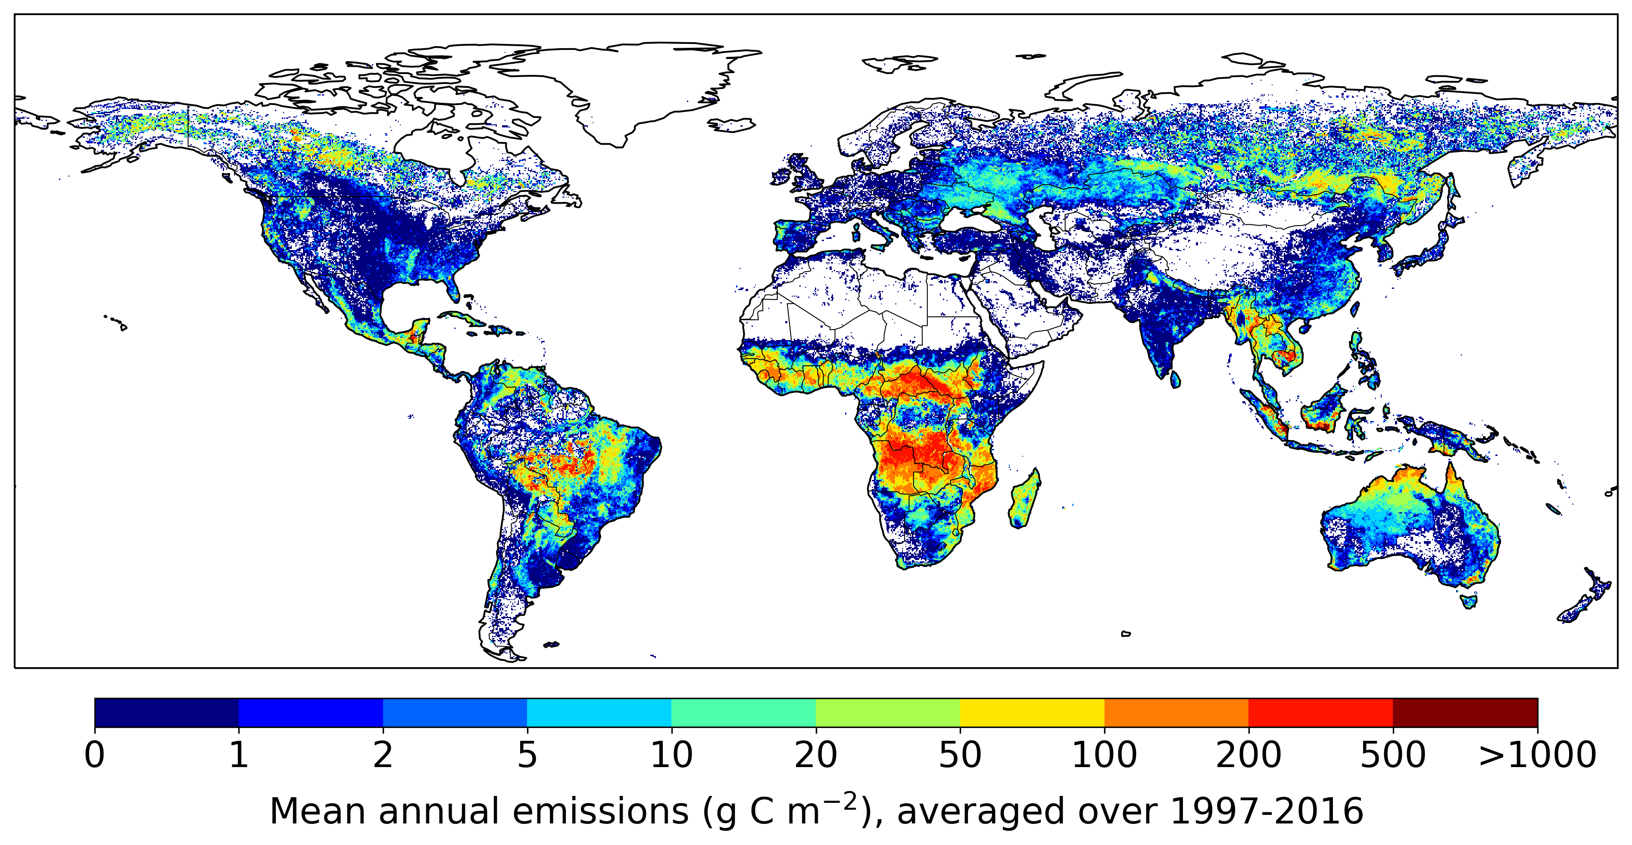
Burned area x Fuel consumption = Fire carbon emissions
Based on GFED data described in Van der Werf et al. (2017, ACPD)
More important role of forests compared to burned area maps

Slide 13
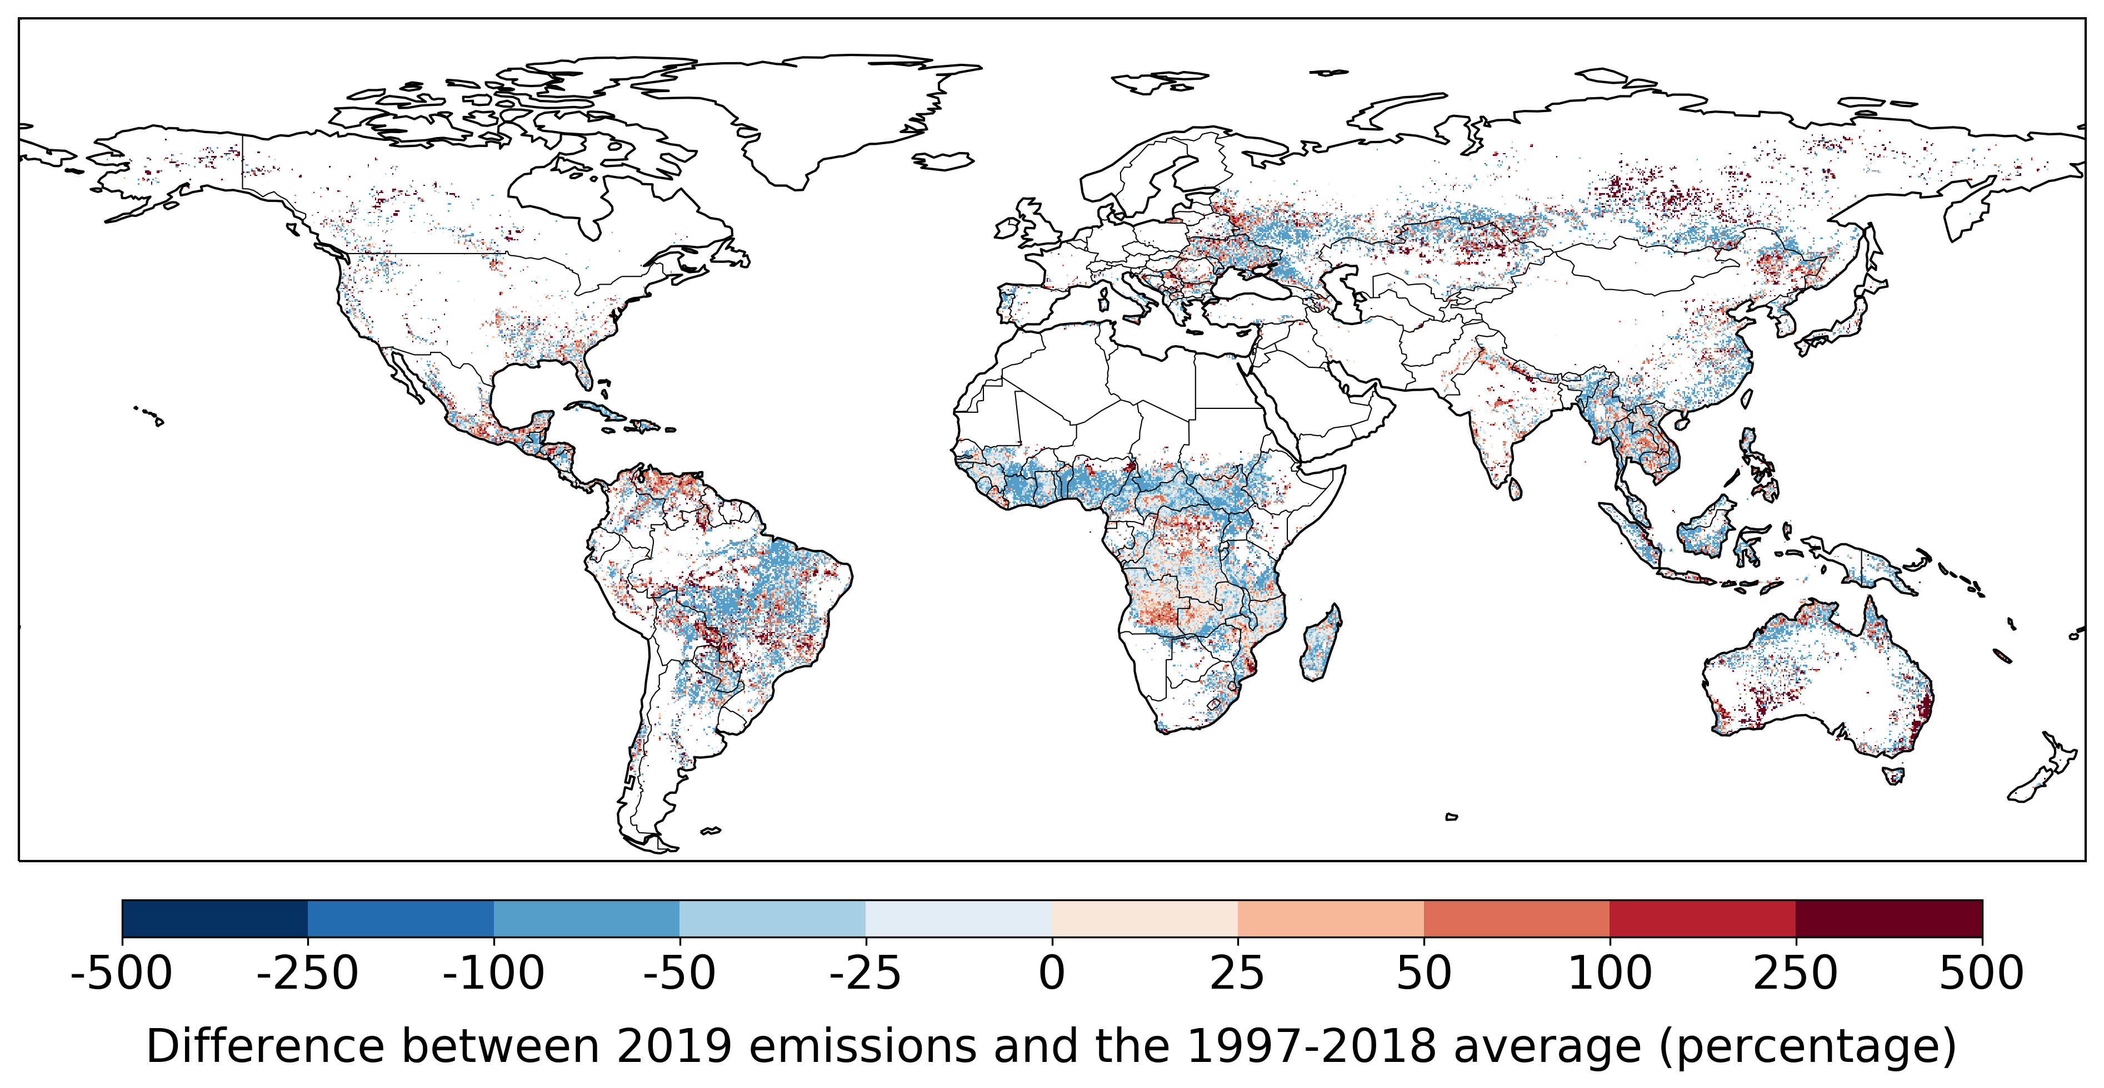
More area with negative anomalies than with positive anomalies in 2019
However, most of the negative anomalies are in areas with low fuel consumption while positive anomalies are in forested landscapes with higher fuel consumption

Slide 14
https://www.bbc.com/news/world-latin-america-49415973
https://twitter.com/emmanuelmacron/status/1164617008962527232

Slide 15
VIIRS era

Slide 16
MODIS era
Amazon droughts of 2005, 2007, 2010

Slide 17
GFED era

Slide 18
Full “observational evidence” era
Based on satellite data since 1997
Before 1997 extension based on visibility (Van Marle et al., 2014)

Slide 19
Full “observational evidence” era
Based on satellite data since 1997
Before 1997 extension based on visibility (Van Marle et al., 2014)
Close link with deforestation rates, except for drought years (2005, 2007, 2010)
2019 was not unprecedented, but it did signal the impact of increased deforestation
Numbers are substantial; 2019 emissions comparable to those from global aviation
Future fire activity depends on both socio-economic decisions and climate change
Long time series matter for perspective!

Slide 20
GFED era

Slide 21
GFED era
Pre-GFED based on Landsat burned area (Stocks et al., 2002; Kasischke et al., 2002)
Gradual increase related to warming with more lightning being a key factor (Veraverbeke et al., 2017, Nature CC)

Slide 24
2019 unprecedented in the Arctic
2019 one of the largest ENSO-neutral fire years
2019 unprecedented in SE Australia’s forests

Slide 25
Giglio et al. (2013); Andela & Van der Werf (2014);
Doerr & Santin (2016); Andela et al. (2017)

Slide 29
Summary
Pyrogeography has been changing and will continue to do so:
  Savanna fires are decreasing
  Forest fires on the rise
Length of fire records matters given that fires are highly variable from year to year; trends become clearer when considering several decades
2019 was exceptional because multiple key fire regions had higher-than-average fire emissions in the same year, with the Arctic circle and Australia having unprecedented fire years
#Flyless; let’s continue to see each other online when possible, keeping our CO₂ emissions low and our credibility high!

Slide 30
Summary
Pyrogeography has been changing and will continue to do so:
  Savanna fires are decreasing
  Forest fires on the rise
Length of fire records matters given that fires are highly variable from year to year; trends become clearer when considering several decades
2019 was exceptional because multiple key fire regions had higher-than-average fire emissions in the same year, with the Arctic circle and Australia having unprecedented fire years
#Flyless; let’s continue to see each other online when possible, keeping our CO₂ emissions low and our credibility high!

Slide 31
Summary
Pyrogeography has been changing and will continue to do so:
  Savanna fires are decreasing
  Forest fires on the rise
Length of fire records matters given that fires are highly variable from year to year; trends become clearer when considering several decades
2019 was exceptional because multiple key fire regions had higher-than-average fire emissions in the same year, with the Arctic circle and Australia having unprecedented fire years
#Flyless; let’s continue to see each other online when possible, keeping our CO₂ emissions low and our credibility high!

Slide 32
Summary
Pyrogeography has been changing and will continue to do so:
  Savanna fires are decreasing
  Forest fires on the rise
Length of fire records matters given that fires are highly variable from year to year; trends become clearer when considering several decades
2019 was exceptional because multiple key fire regions had higher-than-average fire emissions in the same year, with the Arctic circle and Australia having unprecedented fire years
#Flyless; let’s continue to see each other online when possible, keeping our CO₂ emissions low and our credibility high!

